Slide 1
Logic and If Statements
Mr Mack 2021

Slide 2
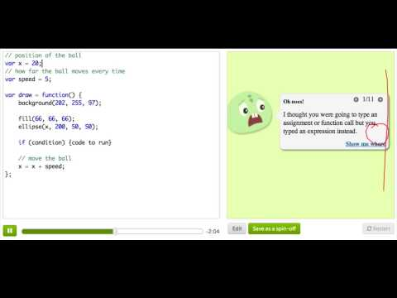
If Statements

Slide 3
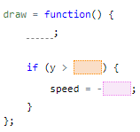
Practice: Bouncy Ball
Our ball is moving down the canvas, but it keeps going down forever. Add an if statement to make it reverse direction once it gets to the bottom of the canvas. Remember you can click restart to re-run the program from the beginning.
Bounce off the floor!

Slide 4
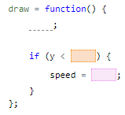
Practice: Bouncy Ball
Okay, now let's get the ball to reverse once it hits the ceiling too, so that it keeps going down and up forever.
Bounce off the ceiling!

Slide 5
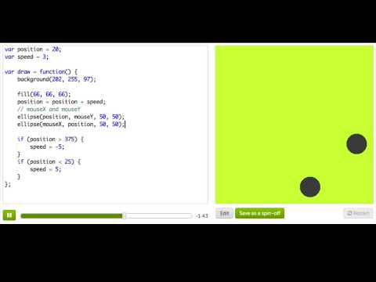
More Mouse Interaction

Slide 6

Practice: Your First Painting App
Try moving your mouse over the canvas. Do you see the circles follow your mouse? Do you notice how it's hard to draw a picture because the computer never stops drawing circles? Let's fix this by making the program draw circles only if your mouse is pressed!
Hint: Be careful with the placement of your (parenthesis) and {brackets}, they have to look exactly like the hint code.
Is the mouse pressed?

Slide 7

Practice: Your First Painting App
Awesome! How's it look? Now, fill the circles in with a color and remove the stroke, so it's more like a paintbrush.
Add some color!

Slide 8
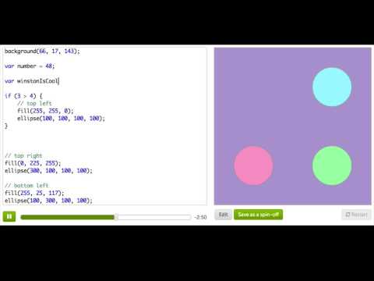
Booleans

Slide 9
Practice: Number Analyzer
Our goal for this challenge is to write a number analyzer program that: displays the number assigned to theNumber, and draws a rectangular outline to show whether theNumber is positive, negative or zero.
Remember that:
- Positive numbers are numbers that are larger than zero
- Negative numbers are numbers that are smaller than zero
- Zero isn't positive and it also isn't negative. The only number that is zero is zero.
Right now, the outline is drawn around ''It's positive'' to show that 100 is positive (because 100 is larger than zero), but our program is not very smart yet. If we change the number, assigned to theNumber, to a number that is not positive, then ''It's positive'' will still be outlined (even though it won't be true anymore), but the correct text (''It's negative'' or ''It's zero'') will not be outlined.
Read through the code now, and then change the number assigned to theNumber to prove that it's not very smart (yet!)
Play with the number

Slide 10

Practice: Number Analyzer
Right now, there's only an outline for ''It's positive''. To make our program smart, we'll need to be able to outline any of the results. Add a rectangle to outline ''It's negative'', and add another rectangle to outline ''It's zero''.
Make all the outlines

Slide 11
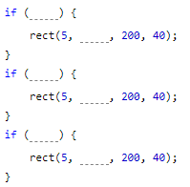
Practice: Number Analyzer
Now use if statements, and the comparison operators you just learned, to control when each outline is drawn.
Try assigning theNumber different numbers, to make sure your program works. Make sure that:
-the outline around ''It's positive'' is only drawn when theNumber is positive.
-the outline around ''It's negative'' is only drawn when theNumber is negative.
-the outline around ''It's zero'' is only drawn when theNumber is zero.
See if your program works correctly when you assign each of these numbers to theNumber:
- positive numbers: 1, 17, 0.2
- negative numbers: -1, -12, -0.35
- zero: 0
Make it smart!

Slide 12
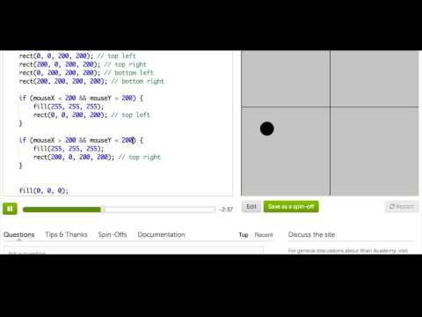
Logical Operators

Slide 13
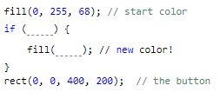
Practice: Your First Button
Buttons often change color when they're pressed, so that the user realizes they've pressed something. In this challenge, you'll change the code so that this button turns red when you press it. For this first step, add an if that colors the button red when you press the mouse anywhere on the canvas.
Is the mouse pressed?

Slide 14

Practice: Your First Button
Did you notice that the rectangle changes its color when you click on the bottom half of the canvas? Buttons aren't supposed to activate when you click outside of them.
You'll fix that now - change the if condition so that the color of the button changes when the mouse is both pressed and on the upper half of the canvas.
But WHERE is the mouse pressed?

Slide 15

Practice: Smarter Button
Right now, if you press anywhere on the canvas, the button will change color (Try it!). We want the button to change color only when we press inside of it. To do that, you'll need to use comparison operators (>, <) with the current mouse x and mouse y position. You'll have to check multiple conditions (like that the x is greater than one number but less than another), so you'll also use &&.
Where is the mouse pressed?

Slide 16
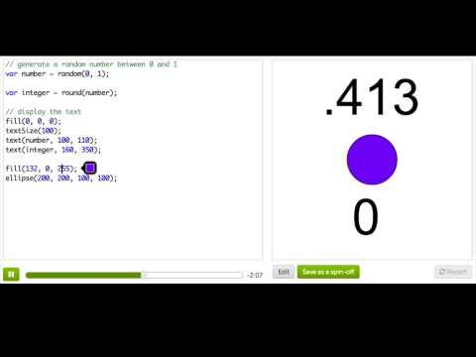
If/Else - Part 1

Slide 17
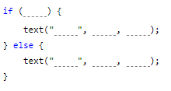
Practice: Flashy Flash Card
In this challenge, you'll make a flash card to help remember fun facts. You'll display the answer when the mouse is pressed, and the question when it isn't.
Hint: Use the mouseIsPressed variable to check if the mouse button is pressed.
Show the answer!

Slide 18
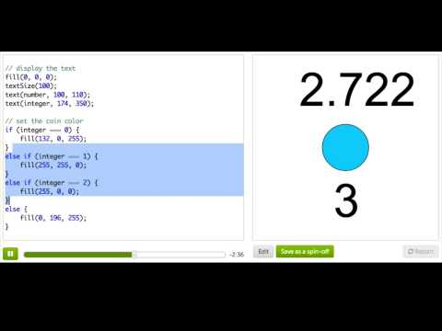
If/Else - Part 2

Slide 19
Review: Logic and if Statements
This is a review of what we covered in this tutorial on logic and if statements.
We often want to be able to "conditionally" do things in our programs - we want to be able to say "if this thing is true, then do X but if this other thing is true, then do Y." It's like when we wake up in the morning - "if it's raining outside, then I take an umbrella, but if it's sunny, I wear sunglasses." We can do things conditionally in our programs using if statements and if/else statements combined with conditional expressions.

Slide 20
Review: Logic and if Statements
An if statement tells the program to execute a block of code, if a condition is true. In the code below, we output a message only if x is greater than 0:
var x = 5;
if (x > 0) {
text('x is a positive number!', 200, 200);
}
Notes:
Since x is 5, which is greater than 0, we would see the message on the canvas. If we changed x to -1, we wouldn't see the message show up at all, since x wouldn't be greater than 0.

Slide 21
Review: Logic and if Statements
The x > 0 is what we call a conditional expression - which means it's an expression that evaluates to either true or false. When a value is either true or false, we call it a boolean value (as opposed to a number or a string). For example, we could just display the conditional expression:
text(x > 0, 200, 200); // Displays "true"
We could also store it into a variable and then display it:
var isPositive = x > 0;
text(isPositive, 200, 200);
Notes:
We would then say that isPositive is storing a boolean value, because it's either true or false, depending on what we set x to.

Slide 22
Review: Logic and if Statements
We have many ways of creating conditional expressions that will evaluate to true or false, because we have many comparison operators. Here are the most popular:
Assuming the following variable, here are the most common comparison operators and expressions that would be true with them:
var myAge = 28;

Slide 23
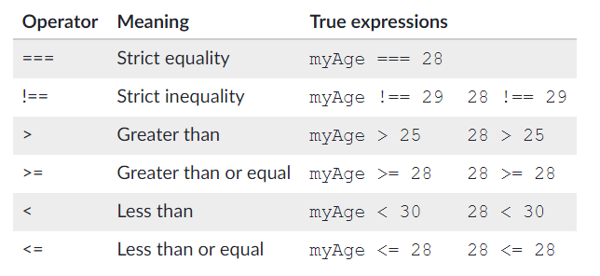
Review: Logic and if Statements

Slide 24
Review: Logic and if Statements
It is a very common mistake to confuse the assignment operator (=) with the equality operator (===), because they both use equal signs, but they are quite different. The assignment operator will actually change the value of the variable, whereas the equality operator will just read the value of the variable and see if it's equal to something. For example:
var x = 2 + 2; // Sets it equal to 4
if (x === 4) { // Asks the question, "does this equal 4?"
text("yep, 2 + 2 = 4!", 200, 200);
}

Slide 25
Review: Logic and if Statements
We sometimes want to combine multiple comparisons together in a conditional expression, and that's why we have logical operators. These operators let us say things like "if both X and Y are true" or "if either X or Y are true" in our programs.
If we want to require that two conditions are both true, we can use the && operator ("and"):
var degreesOutside = 70;
var numberOfClouds = 50;
if (degreesOutside > 70 && numberOfClouds < 5) {
text("Wear sun screen!", 200, 200);
}

Slide 26
Review: Logic and if Statements
We often use that in our programs here for checking that a user's mouse position is inside a rectangle (to mimic a button), in which case we need multiple && operators:
rect(100, 50, 100, 100);
mousePressed = function() {
if (mouseX > 100 && mouseX < 200 && mouseY > 50 && mouseY < 150) {
text("You pressed it!", 80, 75);
}
};

Slide 27
Review: Logic and if Statements
If we only care that at least one condition is true, then we can use the || operator ("or"):
var degreesOutside = 70;
var numberOfClouds = 50;
if (degreesOutside > 70 || numberOfClouds < 5) {
text("Wear sun screen if it's hot outside or there aren't many clouds!", 200, 200);
}

Slide 28
Review: Logic and if Statements
We can use both && and || in the same expression, if we have some very complex condition to check. Just use parentheses to group expressions, so that the program isn't confused about what order to evaluate them:
var myAge = 28;
if ((myAge >= 0 && myAge < 3) || myAge > 90) {
println('You\'re not quite in your peak.');
}

Slide 29
Review: Logic and if Statements
Now let's return to if statements. We often want to execute some block of code in the case that the if condition wasn't true - in that case, we add an else statement.
var age = 28;
if (age > 16) {
println('Yay, you can drive!');
} else {
println('Sorry, but you have ' + (16 - age) + ' years until you can drive.');
}

Slide 30
Review: Logic and if Statements
Sometimes we want to check multiple conditions, and do different things based on each, in which case we can use else if:
var age = 20;
if (age >= 35) {
println('You can vote AND hold any place in government!');
} else if (age >= 30) {
println('You can vote AND run for the Senate!');
} else if (age >= 18) {
println('You can vote!');
} else {
println('You have no voice in government!');
}
Notes:
You can keep checking conditions as much as you want - just make sure that each of your conditions is actually reachable. Test your code by changing variables until you make it inside each of the blocks of code, so that you know it all works.
As you can hopefully now see, conditionals are an important part of programming and let us create much more powerful and flexible programs.

Slide 31
Random numbers
We've been using our if conditions to check values about the environment, like the user's current mouse position, and respond predictably.
But what if we want unpredictability? What if we want our program to act differently each time it runs?
Randomness to the rescue!
We can generate random numbers and use if and else if conditions to change our program's behavior based on the random values.

Slide 32
Random numbers
For example:
var randNum = random(0, 10);
if (randNum < 5) {
text("Trick!", 200, 200);
} else {
text("Treat!", 200, 200);
}
The program outputs "Trick!" half of the time, and "Treat!" the other half.

Slide 33
Random numbers
How it works:
The randNum variable is assigned a random number, starting at 0 and including numbers up to 10. Returned values could include 0, 0.2, 3.3, 4, 5.5, 6.9, 8, 9, or 9.99, but not 10 itself.
The condition checks if the returned number is less than 5, outputting "Trick!" if so and "Treat!' otherwise.

Slide 34
Random numbers
Sometimes it's easier to deal with whole numbers instead of floating point numbers, so that we can check exact values. Here are a few functions that turn floating point numbers into integers:
round(): Rounds a number down to the nearest integer if the decimal portion is lower than .5 and rounds up if the decimal portion is .5 or greater.
ceil(): Always rounds a number up to the next integer.
floor(): Always rounds a number down to an integer.
Typically we want to generate random numbers that are picked relatively evenly. For example, if we are simulating flipping a coin, then we expect there to be an equal chance of either "Heads" or "Tails".

Slide 35
Random numbers
This code accomplishes that goal:
var randFlip = floor(random(0, 2));
if (randFlip === 0) {
text("Heads", 200, 200);
} else {
text("Tails", 200, 200);
}
The variable randFlip will always be either 0 or 1, since it calls floor() on the return value of random(0, 2).

Slide 36
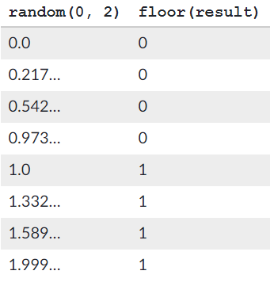
Random numbers
To give you a feel for why that's the case, here's the result of calling floor() on various values from random(0, 2):

Slide 37
Random numbers
The return values from random() are random, so they won't necessarily look as equally distributed as the values in that table. If you run the coin-flipping code just 10 times, you might see a string of all "Heads" or all "Tails". However, if you run it thousands of times and keep count, you'll see "Heads" and "Tails" each about 50% of the time.
As a general rule, when our goal is to obtain a fair and even distribution of integer values, it is best to use floor() with random(). [Why not ceil()?]
The random() function is a great way to add a little variety to your programs. However, use it carefully: figure out the range of numbers that you're generating, decide whether you need to round the numbers, and check the values appropriately.

Slide 38
Challenge: Magic 8-Ball
Ever played with a magic 8-ball? It's a toy that displays a random message every time you shake it, such as "It is certain" or "My sources say no." In this project, you'll create your own magic 8-ball using if/else statements, so that you can use your program to answer your deepest questions about life.
Change the if() to check if the answer variable equals a certain number and change the text of the starter message.
Tip: Click restart until you see the message show up.
Add else if() statements to check for all the other possible values of the answer variable, and show a different message for each value.
Tip: For easy testing of specific values, you can add a line like var answer = 1 below the line that generates random numbers, then click restart to test it. Make sure you remove that debugging line before you send the project for evaluation.
Bonus: Give every message a different style, by changing the color, adding illustrations, or changing the text styles. There are lots of text related commands in the documentation to play with!
You can play with the numbers in floor(random(1, 5)) as long as you have at least 3 possible values for the answer variable, but don’t remove floor() or random(). The combination is the best way to create a reasonably even statistical distribution of values. To understand why, re-read the article on generating random numbers.

